Slide 1
Process Improvement

Slide 2
Objectives
To explain the principles of software process improvement
To explain how software process factors influence software quality and productivity
To explain how to develop simple models of software processes
To explain the notion of process capability and the CMMI process improvement model

Slide 3
Topics covered
Process and product quality
Process classification
Process measurement
Process analysis and modelling
Process change
The CMMI process improvement framework

Slide 4
Process improvement
Understanding existing processes and introducing process changes to improve product quality, reduce costs or accelerate schedules.
Most process improvement work so far has
focused on defect reduction. This reflects the increasing attention paid by industry to quality.
However, other process attributes can also be the focus of improvement

Slide 5
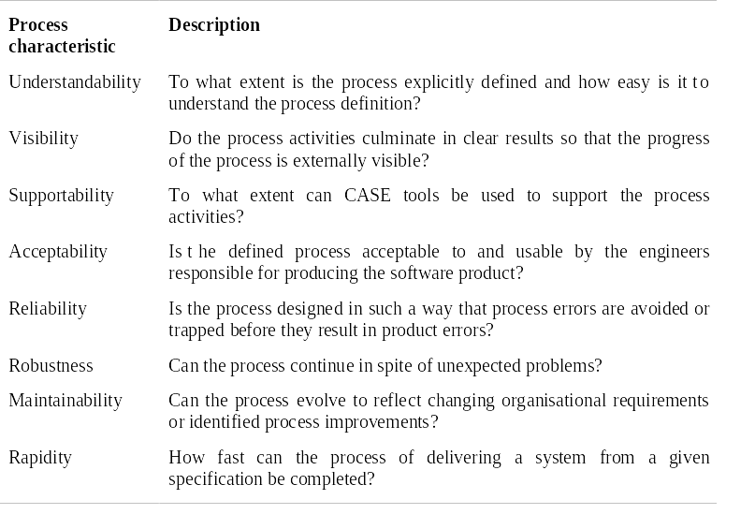
Process attributes

Slide 6
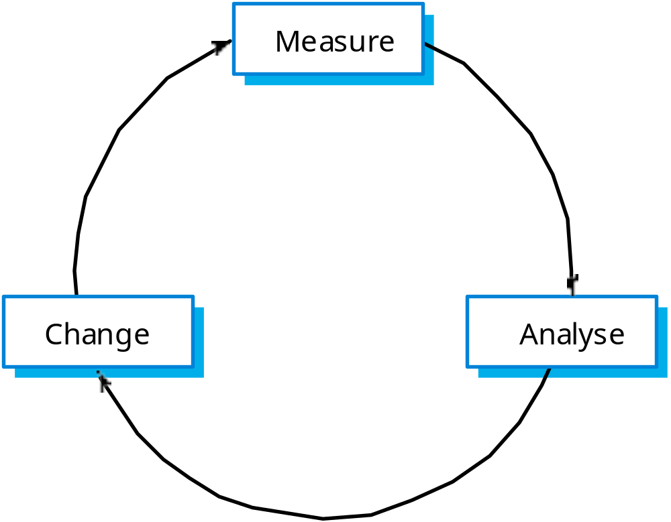
The process improvement cycle

Slide 7
Process improvement stages
Process measurement
  Attributes of the current process are measured. These are a baseline for assessing improvements.
Process analysis
  The current process is assessed and bottlenecks and weaknesses are identified.
Process change
  Changes to the process that have been identified during the analysis are introduced.

Slide 8
Process and product quality
Process quality and product quality are closely
related and process improvement benefits arise because the quality of the product depends on its development process.
A good process is usually required to produce a
good product.
For manufactured goods, process is the
principal quality determinant.
For design-based activity, other factors are also involved especially the capabilities of the designers.

Slide 9
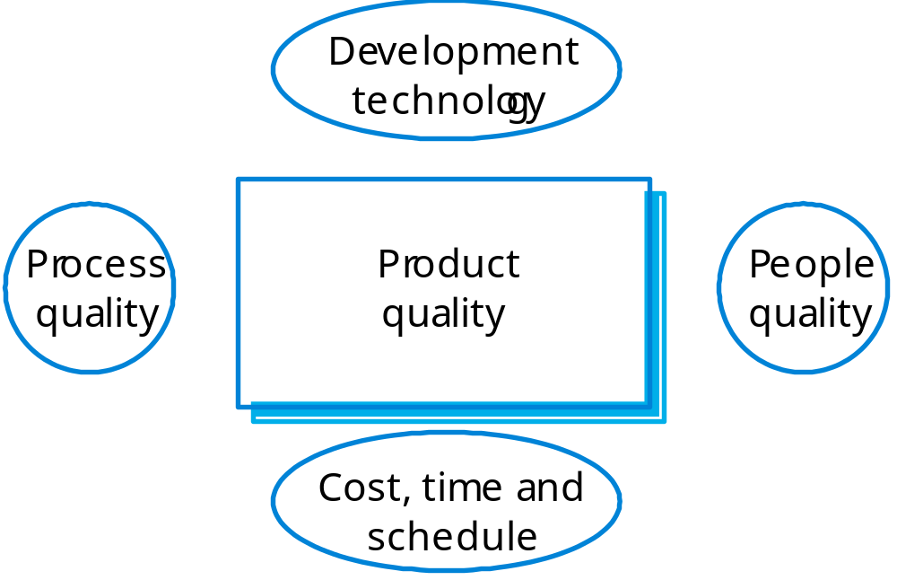
Principal product quality factors

Slide 10
Quality factors
For large projects with ‘average’ capabilities, the development process determines product quality.
For small projects, the capabilities of the developers is the main determinant.
The development technology is particularly significant for small projects.
In all cases, if an unrealistic schedule is imposed then product quality will suffer.

Slide 11
Process classification
Informal
  No detailed process model. Development team chose their own way of working.
Managed
  Defined process model which drives the development
  process.
Methodical
  Processes supported by some development method such
  as the RUP.
Supported
  Processes supported by automated CASE tools.

Slide 12
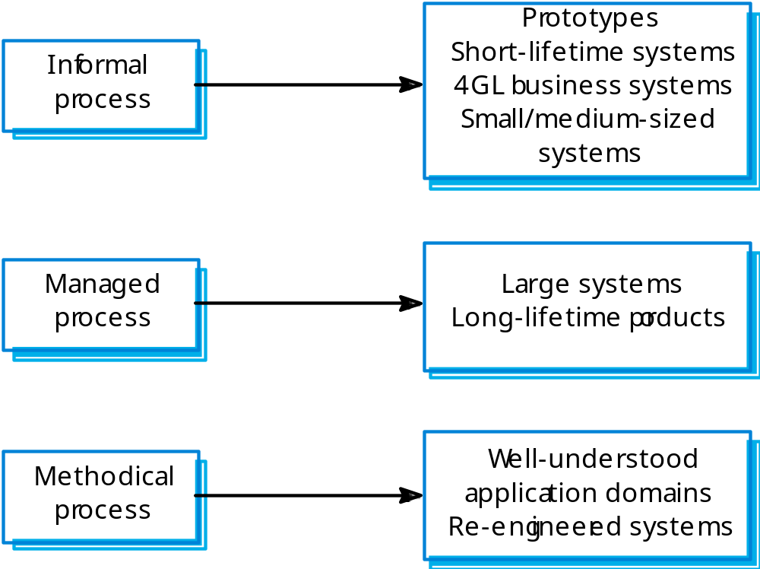
Process applicability

Slide 13
Process choice
Process used should depend on type of
product which is being developed
  For large systems, management is usually the principal problem so you need a strictly managed process;
  For smaller systems, more informality is possible.
There is no uniformly applicable process which
should be standardised within an organisation
  High costs may be incurred if you force an inappropriate process on a development team;
  Inappropriate methods can also increase costs and lead to reduced quality.

Slide 14
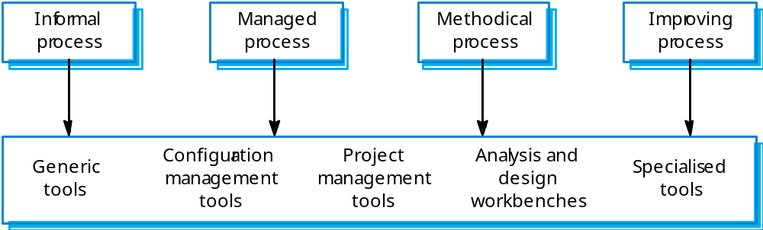
Process tool support

Slide 15
Process measurement
Wherever possible, quantitative process data
should be collected
  However, where organisations do not have clearly defined process standards this is very difficult as you don’t know what to measure. A process may have to be defined before any measurement is possible.
Process measurements should be used to
assess process improvements
  But this does not mean that measurements should drive the improvements. The improvement driver should be the organizational objectives.

Slide 16
Classes of process measurement
Time taken for process activities to be
completed
  E.g. Calendar time or effort to complete an activity or process.
Resources required for processes or activities
  E.g. Total effort in person-days.
Number of occurrences of a particular event
  E.g. Number of defects discovered.

Slide 17
Goal-Question-Metric Paradigm
Goals
  What is the organisation trying to achieve? The objective of process improvement is to satisfy these goals.
Questions
  Questions about areas of uncertainty related to the goals. You need process knowledge to derive these.
Metrics
  Measurements to be collected to answer the questions.

Slide 18
Process analysis and modelling
Process analysis
  The study of existing processes to understand the relationships between parts of the process and to compare them with other processes.
Process modelling
  The documentation of a process which records the tasks, the roles and the entities used;
  Process models may be presented from different perspectives.

Slide 19
Process analysis and modelling
Study an existing process to understand its
activities.
Produce an abstract model of the process. You should normally represent this graphically. Several different views (e.g. activities, deliverables, etc.) may be required.
Analyse the model to discover process
problems. This involves discussing process activities with stakeholders and discovering problems and possible process changes.

Slide 20
Process analysis techniques
Published process models and process
standards
  It is always best to start process analysis with an existing model. People then may extend and change this.
Questionnaires and interviews
  Must be carefully designed. Participants may tell you what they think you want to hear.
Ethnographic analysis
  Involves assimilating process knowledge by observation. Best for in-depth analysis of process fragments rather than for whole-process understanding.

Slide 21
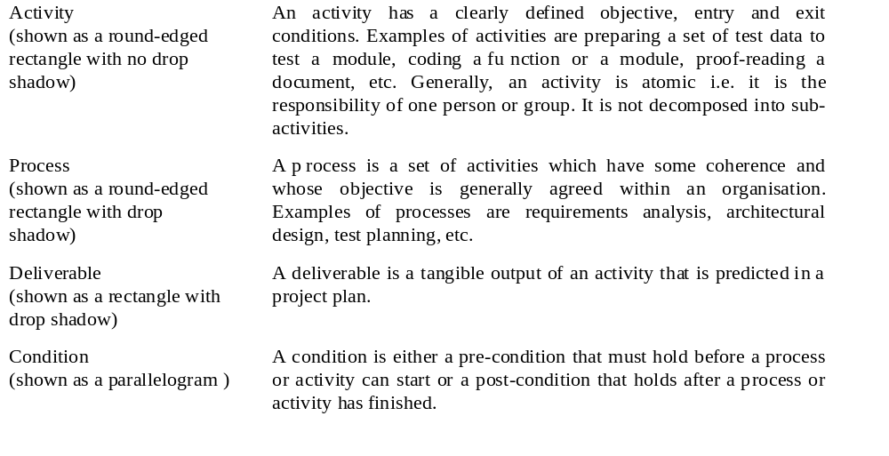
Process model elements 1

Slide 22
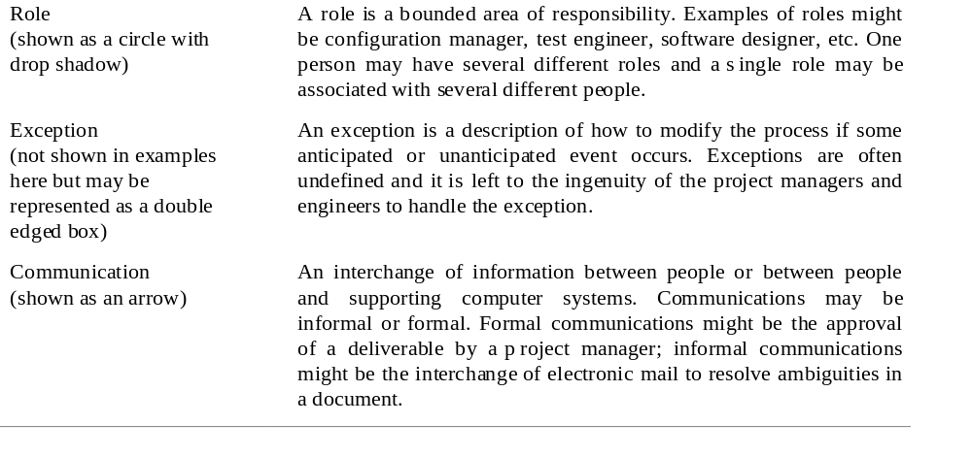
Process model elements 2

Slide 23
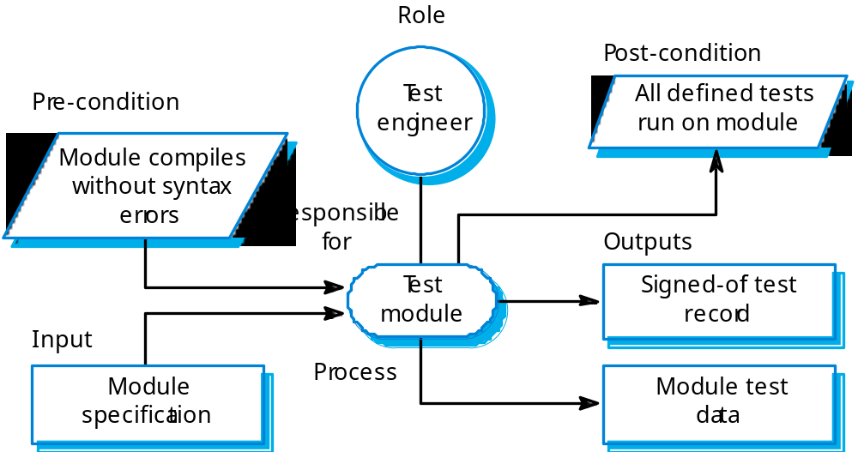
The module testing activity

Slide 24
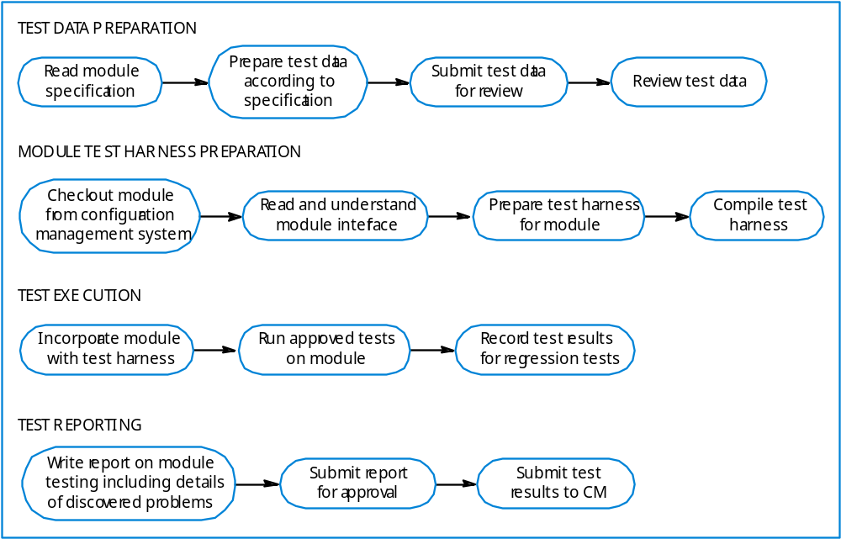
Activities in module testing

Slide 25
Process exceptions
Software processes are complex and process models cannot effectively represent how to handle exceptions:
  Several key people becoming ill just before a critical review;
  A breach of security that means all external communications are out of action for several days;
  Organisational reorganisation;
  A need to respond to an unanticipated request for new proposals.
Under these circumstances, the model is suspended and managers use their initiative to deal with the exception.

Slide 26
Process change
Involves making modifications to existing processes.
This may involve:
  Introducing new practices, methods or processes;
  Changing the ordering of process activities;
  Introducing or removing deliverables;
  Introducing new roles or responsibilities.
Change should be driven by measurable goals.

Slide 27
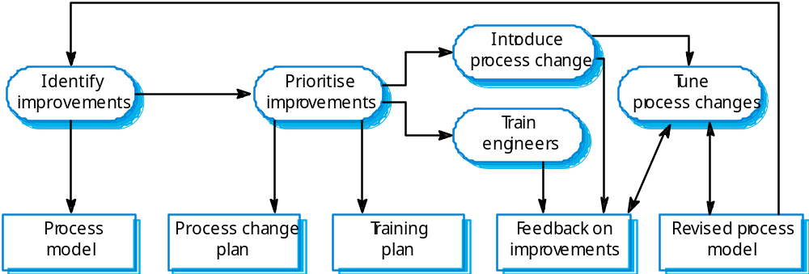
The process change process

Slide 28
Process change stages
Improvement identification.
Improvement prioritisation.
Process change introduction.
Process change training.
Change tuning.

Slide 29
The CMMI framework
The CMMI framework is the current stage of work on process assessment and improvement that started at the Software Engineering Institute in the 1980s.
The SEI’s mission is to promote software technology transfer particularly to US defence contractors.
It has had a profound influence on process improvement
  Capability Maturity Model introduced in the early 1990s.
  Revised maturity framework (CMMI) introduced in 2001.

Slide 30
Process capability assessment
Intended as a means to assess the extent to which an organisation’s processes follow best practice.
My providing a means for assessment, it is possible to identify areas of weakness for process improvement.
There have been various process assessment and improvement models but the SEI work has been most influential.

Slide 31
The SEI capability maturity model
Initial
  Essentially uncontrolled
Repeatable
  Product management procedures defined and used
Defined
  Process management procedures and strategies defined
  and used
Managed
  Quality management strategies defined and used
Optimising
  Process improvement strategies defined and used

Slide 32
Problems with the CMM
Practices associated with model levels
  Companies could be using practices from different levels at the same time but if all practices from a lower level were not used, it was not possible to move beyond that level
Discrete rather than continuous
  Did not recognise distinctions between the top and the bottom of levels
Practice-oriented
  Concerned with how things were done (the practices) rather than the goals to be achieved.

Slide 33
The CMMI model
An integrated capability model that includes software and systems engineering capability assessment.
The model has two instantiations
  Staged where the model is expressed in terms of capability levels;
  Continuous where a capability rating is computed.

Slide 34
CMMI model components
Process areas
  24 process areas that are relevant to process capability and improvement are identified. These are organised into 4 groups.
Goals
  Goals are descriptions of desirable organisational states. Each process area has associated goals.
Practices
  Practices are ways of achieving a goal - however, they are advisory and other approaches to achieve the goal may be used.

Slide 35
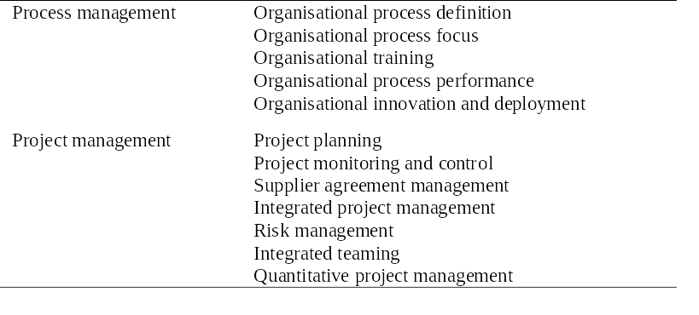
CMMI process areas 1

Slide 36
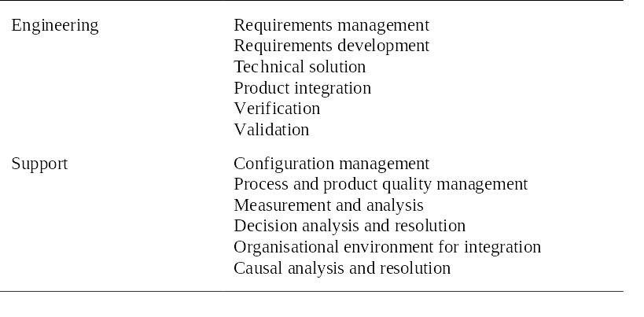
CMMI process areas 2

Slide 37
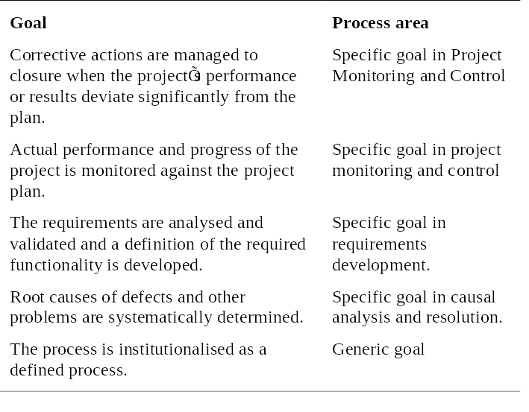
CMMI goals

Slide 38
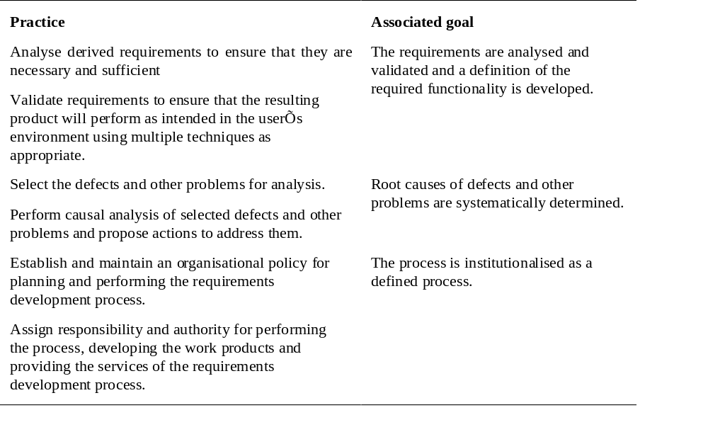
CMMI practices

Slide 39
CMMI assessment
Examines the processes used in an organisation and assesses their maturity in each process area.
Based on a 6-point scale:
  Not performed;
  Performed;
  Managed;
  Defined;
  Quantitatively managed;
  Optimizing.

Slide 40
The staged CMMI model
Comparable with the software CMM.
Each maturity level has process areas and goals. For example, the process area associated with the managed level include:
  Requirements management;
  Project planning;
  Project monitoring and control;
  Supplier agreement management;
  Measurement and analysis;
  Process and product quality assurance.

Slide 41
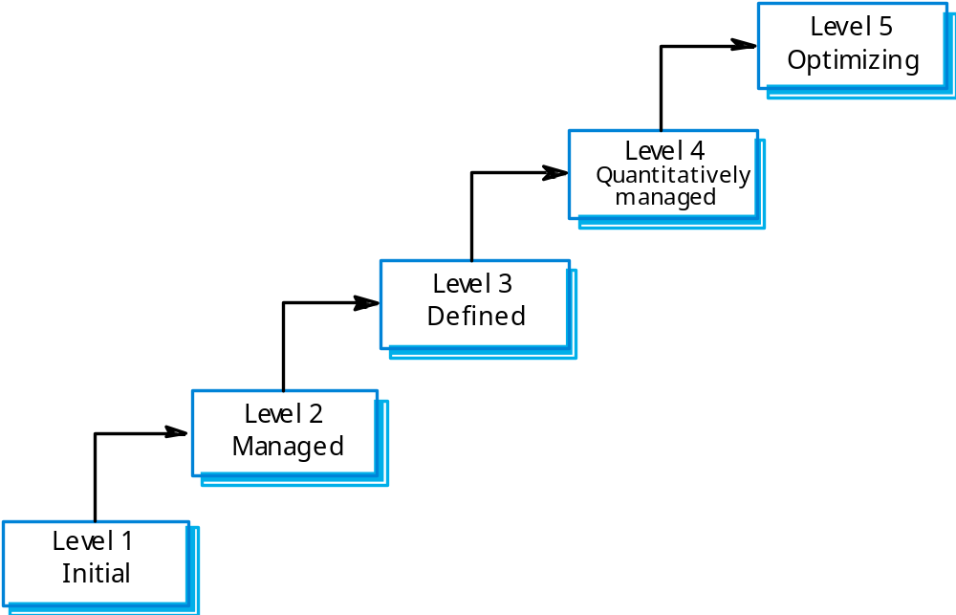
The staged CMMI model

Slide 42
Institutional practices
Institutions operating at the managed level should have institutionalised practices that are geared to standardisation.
  Establish and maintain policy for performing the project management process;
  Provide adequate resources for performing the project management process;
  Monitor and control the project planning process;
  Review the activities, status and results of the project planning process.

Slide 43
The continuous CMMI model
This is a finer-grain model that considers individual or groups of practices and assesses their use.
The maturity assessment is not a single value but is a set of values showing the organisations maturity in each area.
The CMMI rates each process area from levels 1 to 5.
The advantage of a continuous approach is that organisations can pick and choose process areas to improve according to their local needs.

Slide 44
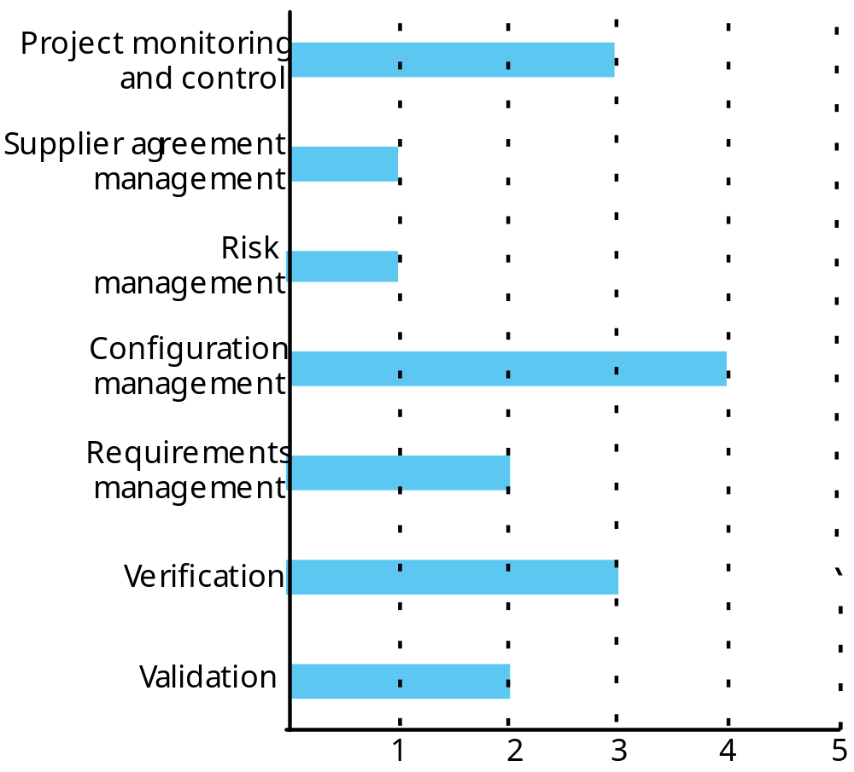
A process capability profile

Slide 45
Key points
Process improvement involves process analysis, standardisation, measurement and change.
Processes can be classified as informal, managed, methodical and improving. This classification can be used to identify process tool support.
The process improvement cycle involves process measurement, process analysis and process change.
Process measurement should be used to answer specific process questions, based on organisational improvement goals.

Slide 46
Key points
The three types of process metrics used in the measurement process are time metrics, resource utilisation metrics and event metrics.
Process models include descriptions of tasks, activities, roles, exceptions, communications, deliverables and other processes.
The CMMI process maturity model integrates software and systems engineering process improvement.
Process improvement in the CMMI model is based on reaching a set of goals related to good software engineering practice.

